Slide 1
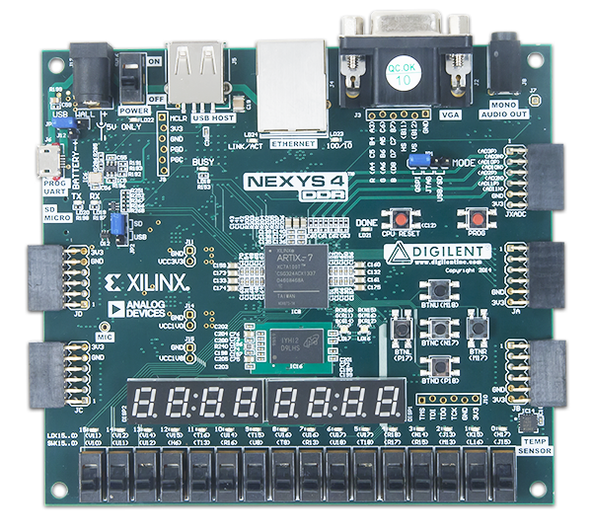
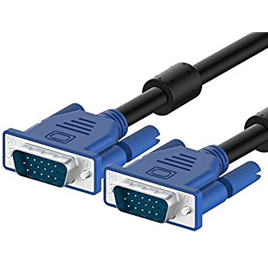

VGA Multi-Photo Display
Team Execution Time

Slide 2
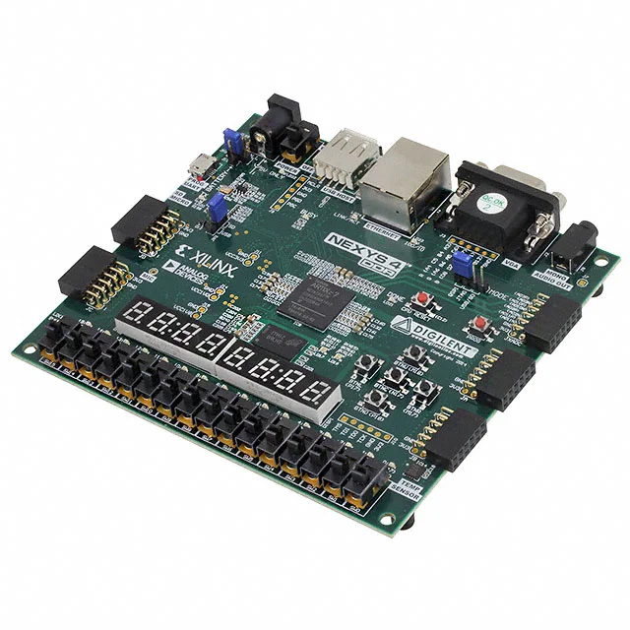
Introduction:
Already built VGA port on board (Nexys 4 DDR, using Artix-7 FPGA).
Wanted to display multiple photos using switches.
Required use of .mem files to place on board memory.
Chose 640x360 dimensions, Nexys 4 ddr can hold up to 800x600.
Had to build a memory block to accept the image and it’s color palette in hex.
Wanted to implement AES encryption for the images.

Slide 3
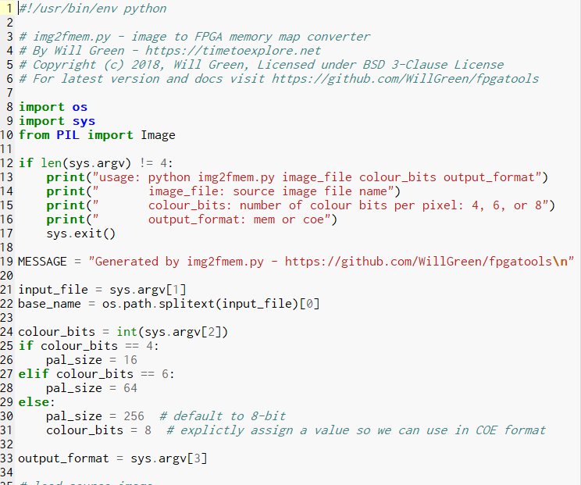
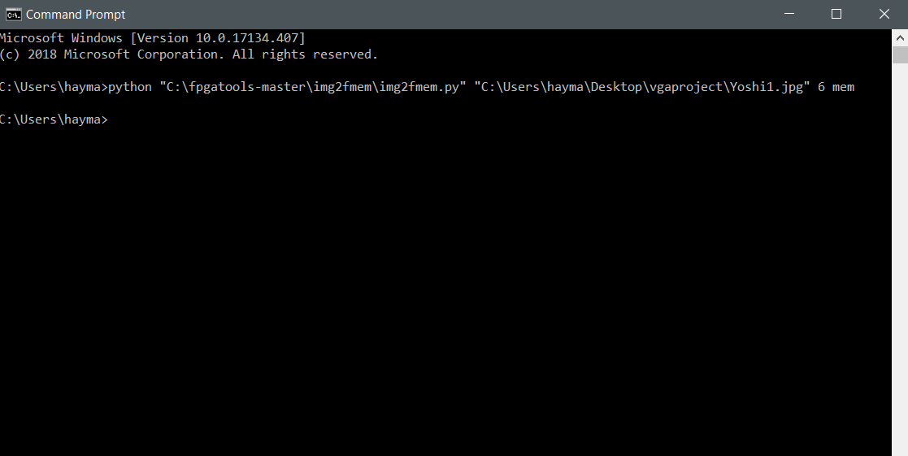
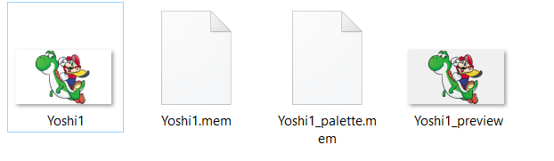
Use of .mem Files
Using a Python script to translate the image, it would output a .mem file for the color palette (64 lines of 12 bit hex), and a much larger .mem file for the image where each pixel was designated (in 8 bit hex).
It also presented a preview image, which showed what the image should look like when it’s displayed using both .mem files.
Python script was limited to using images already below 100kb, due to size limitations. When pressed above that, it would translate, but the image .mem file wouldn’t be proper, therefore wouldn’t present.

Slide 4
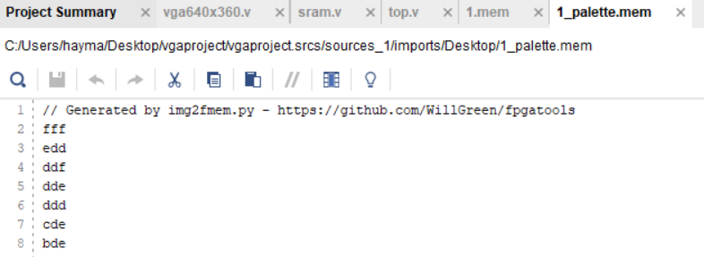
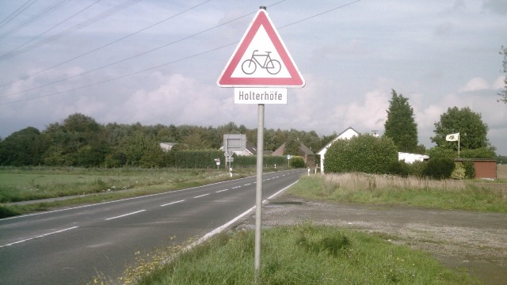
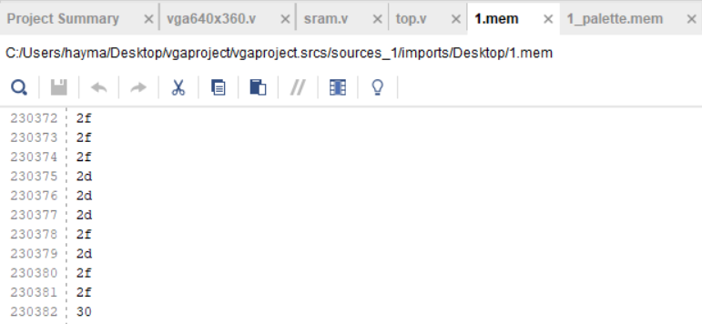
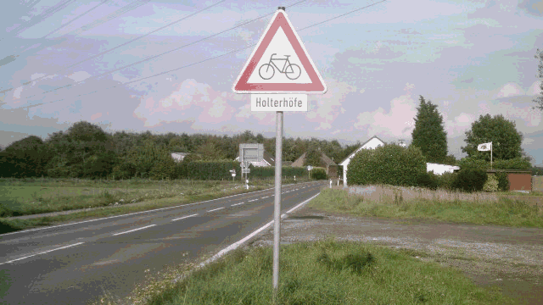
Original image
Image preview (what it will look like displayed)

Slide 5
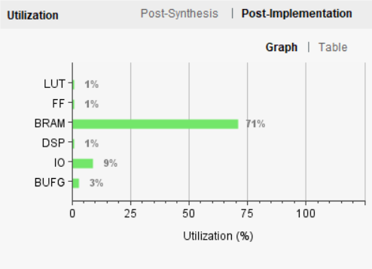
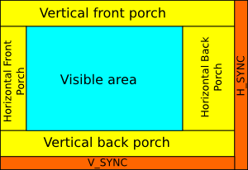
Why 640x360?
Board limitations make it hard to make it any larger than this, if we want multiple photos added.
Using 6 bit color, we multiply 360, 640, and 6 to reach 1,350Kb. Nexys 4 DDR has a max Block RAM of 4Mb, allowing us to display 2 photos comfortably.
6 bit color allows for a max of 64 colors for the palette.
Using $readmemh, the program can read our color palette and image .mem files.
Clock has to be at 25MHz for standard monitors with VGA ports.
Display from [5]

Slide 6
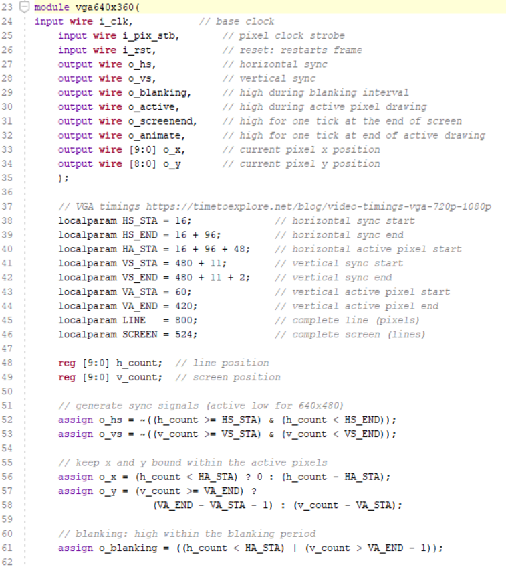
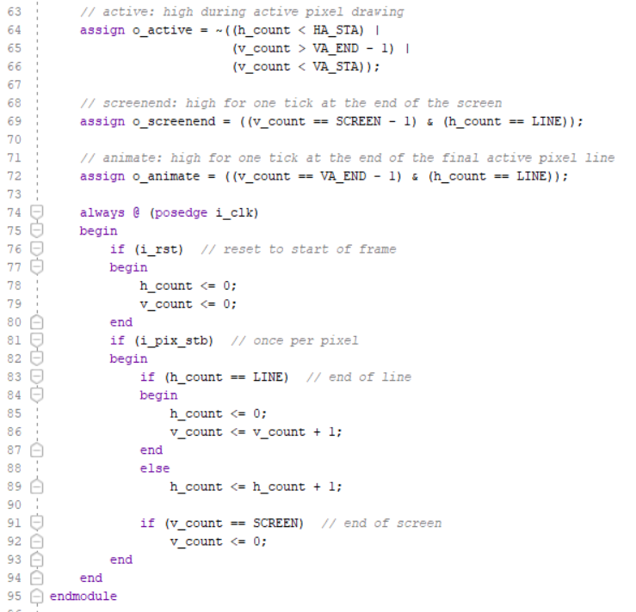
VGA640x360.v

Slide 7
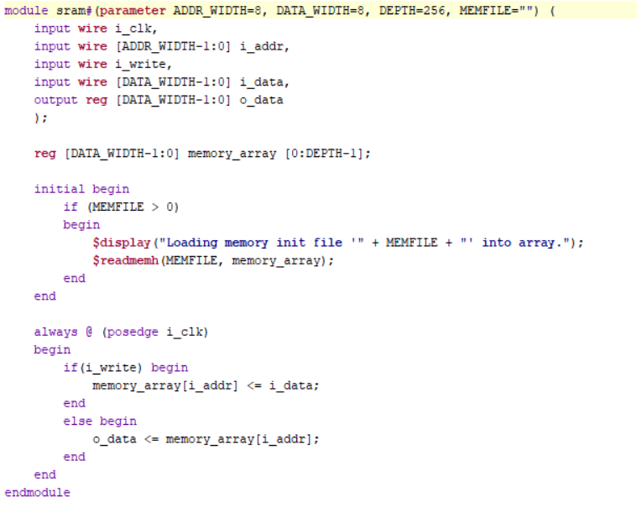
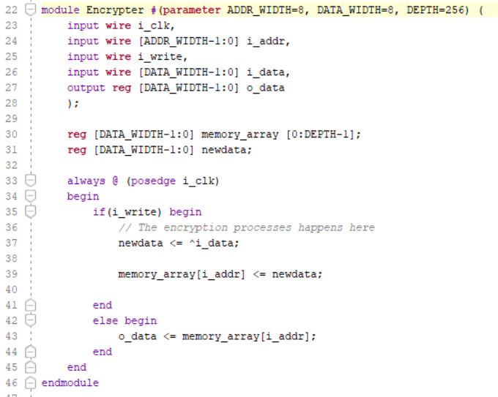
SRAM.v and Encrypter

Slide 8
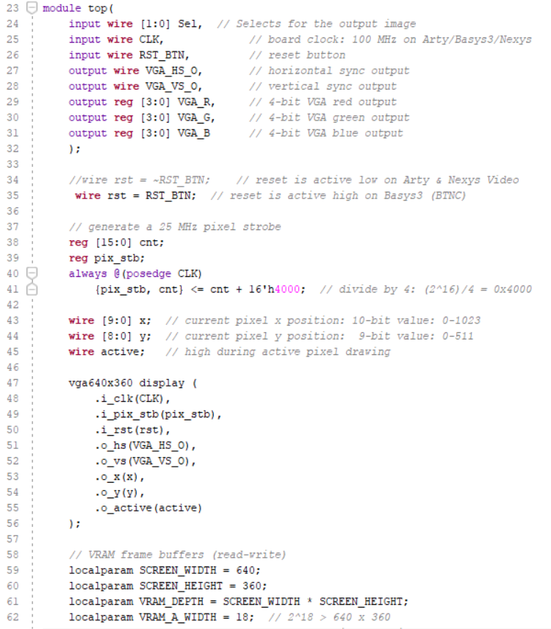
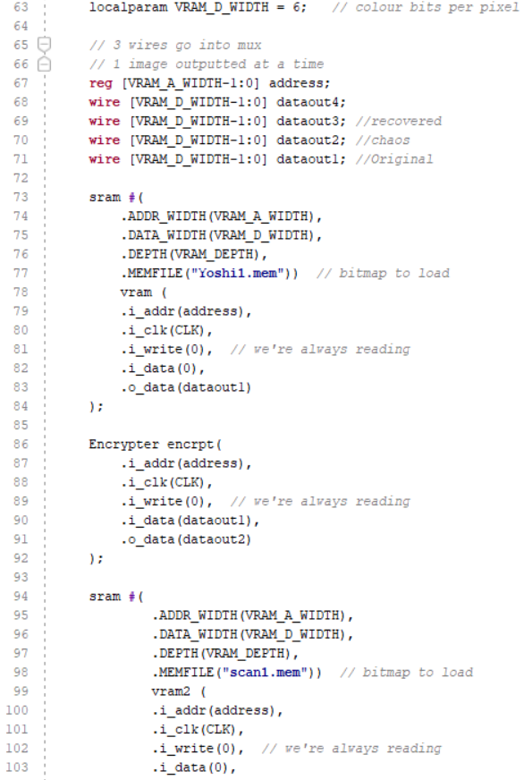
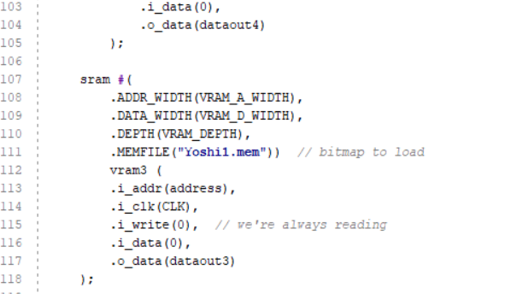
top.v

Slide 9
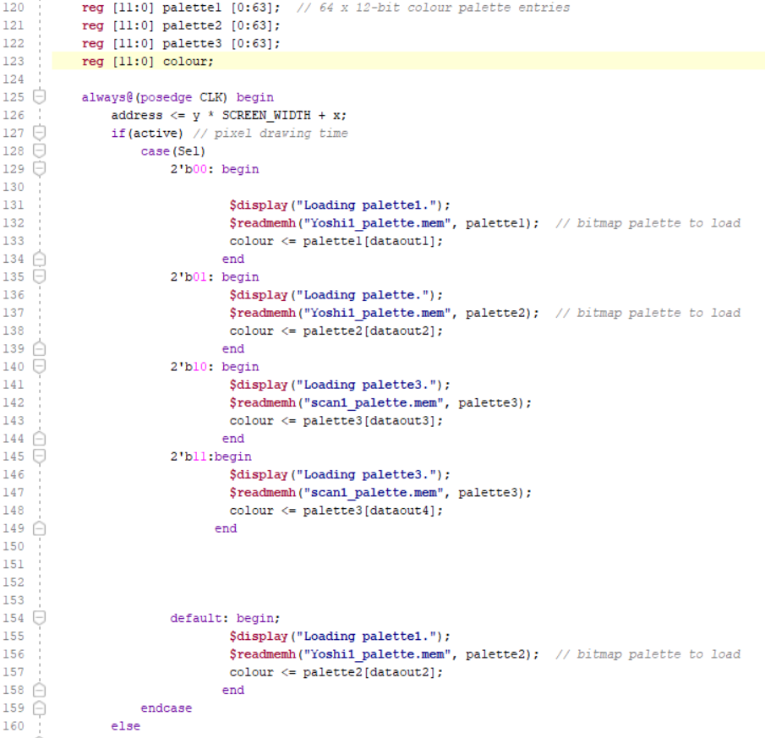
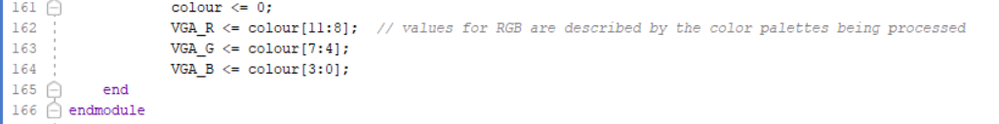
Implementing Switches
Adding a case statement to pick based on the input given by the switches, an image is asked to present with it’s color palette.
There is a default image displayed, which is switched when user uses one of the 1st two switches.

Slide 10
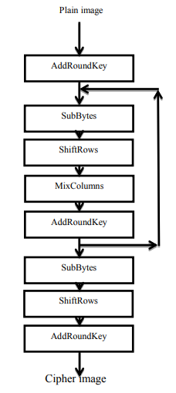
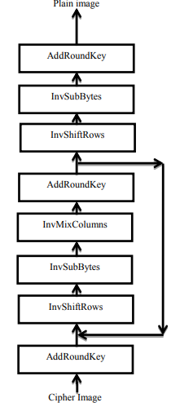
Encryption
Used AES, or Advanced Encryption Standard.
Done within 128-bit, since our file is not that large, as well as not necessary for 256+ bit encryption.
AES can be broken down into 4 parts:
SubstituteBytes
ShiftRow
MixColumns
AddRoundKey
Add Round Key
Inverse Shift Row
Inverse Substitute Byte
Inverse Mix Columns

Slide 11

Demo:
Using the Nexys 4 DDR board connected via USB for power and to program, and a VGA cable between the monitor and board.
Using the first two switches, there will display 2 different images. Will show one image with Yoshi and Mario disappearing, and with the wrong color scheme (on purpose).

Slide 12
Resources
[1]“VGA Timing Information.” Martin Hinner's Homepage, martin.hinner.info/vga/timing.html.
[2]Green, Will. “Video Timings: VGA, SVGA, 720P, 1080P.” Time to Explore, timetoexplore.net/blog/video-timings-vga-720p-1080p.
[3]Green, Will. “FPGA VGA Graphics in Verilog Part 2.” Time to Explore, timetoexplore.net/blog/arty-fpga-vga-verilog-02.
[4] Ghoradkar, Sneha; Shinde, Aparna. “Review on Image Encryption and Decryption using AES Algorithm.” https://pdfs.semanticscholar.org/714f/df79dacb11979701a702d6169de18b7f88bc.pdf
[5]Dumont, Nathan. VGA Primer, nathandumont.com/blog/vga-primer.

